Slide 1
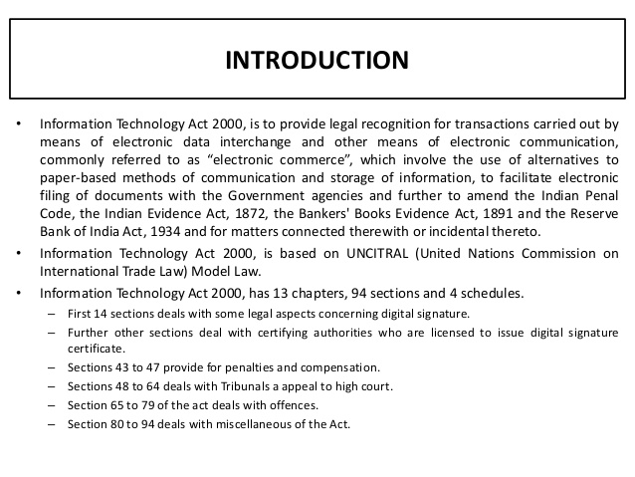
Cyber Laws
The United Nations General Assembly have adopted the Model Law on Electronic Commerce on 30th January 1997 known as United Nations Commission on International Trade Law (UNCITRAL) on E-Commerce
Enacted on 17th May 2000 – India is 12th nation in the world to adopt cyber laws
India passed the Information Technology Act, 2000 on 17th October 2000
Amended on 27th October 2009
Amended Act is know as – The Information Technology (amendment) Act, 2008

Slide 2
Objectives of IT Act
To provide legal recognition for transactions:
  Carried out by means of electronic data interchange, and
  Other means of electronic communication, commonly referred to as “electronic commerce”, involving the use of alternatives to paper-based methods of communication and storage of information
To facilitate electronic filing of documents with the Government agencies
To amend the Indian Penal Code, the Indian Evidence Act, 1872, the Bankers' Book Evidence Act, 1891 and the Reserve Bank of India Act, 1934

Slide 3
Salient features of information technology act
  The Act gives legal recognition of Electronic Documents.
  The Act gives legal recognition of Digital Signatures.
  It describes and elaborates Offenses, penalties and Contraventions.
  It gives outline of the Justice Dispensation Systems for cyber crimes.
  The Act also provides for the constitution of the Cyber Regulations Advisory Committee, which shall advice the government as regards any rules, or for any other purpose connected with the said act.
  The said Act also proposed to amend to; The Indian Penal Code, 1860, The Indian Evidence Act, 1872, The Bankers' Books Evidence Act, 1891, The Reserve Bank of India Act, 1934 etc.
IT Act is not applicable to
  A negotiable instrument (other than a cheque) as defined section13 of the Negotiable Instruments Act, 1881;
  A power-of-attorney as defined in section 1A of the Powers-of-Attorney Act, 1882;
  A trust as defined in section 3 of the Indian Trusts Act, 1882;
  A will as defined in clause (h) of section 2 of the India Succession Act, 1925 including any other testamentary disposition
  Any contract for the sale or conveyance of immovable property or any interest in such property
  Any such class of documents or transactions as may be notified by the Central Government

Slide 4
Terms under IT Act
Adjudicating Officer
Digital Signature
Affixing digital signature
Appropriate Government
Certifying Authority
Cyber Appellate Tribunal
Electronic Form
Secure System
Electronic Gazettee
Highlights of the Amendment Act, 2008
It focuses on privacy issues.
It focuses on Information Security.
It came with surveillance on Cyber Cases.
The Concept of Digital Signature was elaborated.
It clarified reasonable security practices for corporate.
Role of Intermediaries were focused.
It came with the Indian Computer Emergency Response Team.
New faces of Cyber Crime were added.

Slide 5
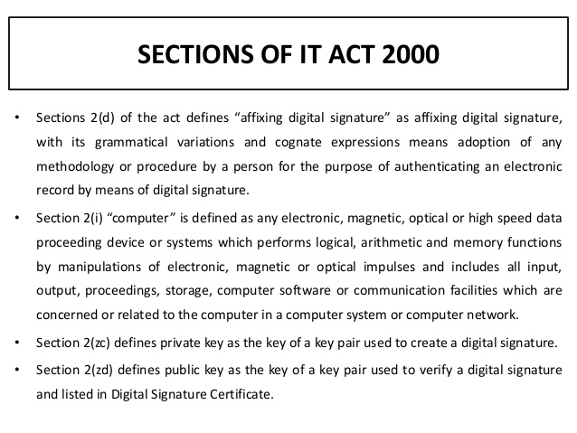

Slide 6
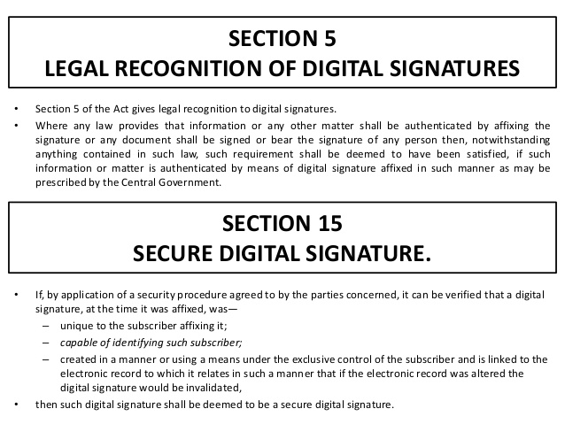

Slide 7
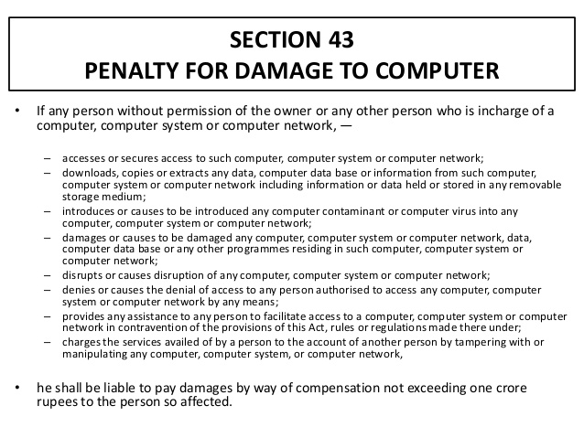

Slide 8


The Public and Private key pair comprise of two uniquely related cryptographic keys (basically long random numbers). Below is an example of a Public Key:
3048 0241 00C9 18FA CF8D EB2D EFD5 FD37 89B9 E069 EA97 FC20 5E35 F577 EE31 C4FB C6E4 4811 7D86 BC8F BAFA 362F 922B F01B 2F40 C744 2654 C0DD 2881 D673 CA2B 4003 C266 E2CD CB02 0301 0001
The Public Key is what its name suggests - Public. It is made available to everyone via a publicly accessible repository or directory. On the other hand, the Private Key must remain confidential to its respective owner.
Because the key pair is mathematically related, whatever is encrypted with a Public Key may only be decrypted by its corresponding Private Key and vice versa.
For example, if Bob wants to send sensitive data to Alice, and wants to be sure that only Alice may be able to read it, he will encrypt the data with Alice's Public Key. Only Alice has access to her corresponding Private Key and as a result is the only person with the capability of decrypting the encrypted data back into its original form.
As only Alice has access to her Private Key, it is possible that only Alice can decrypt the encrypted data. Even if someone else gains access to the encrypted data, it will remain confidential as they should not have access to Alice's Private Key.

Slide 9
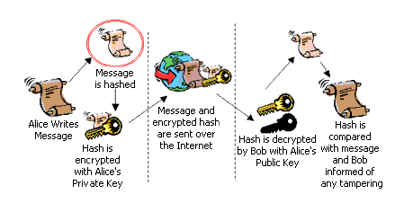
Digital Signature

Slide 10
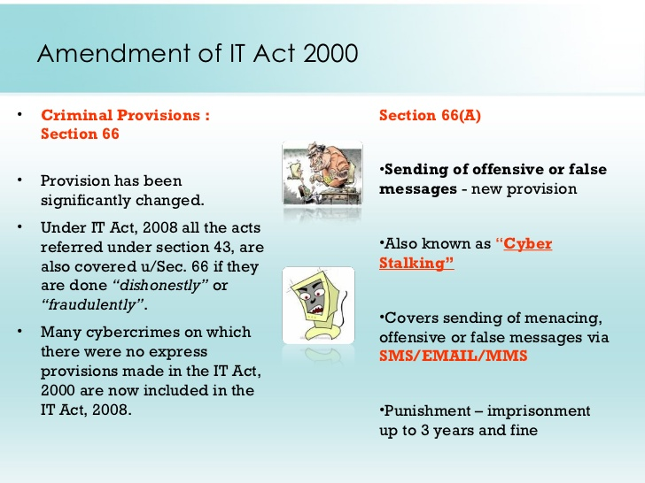

Slide 11
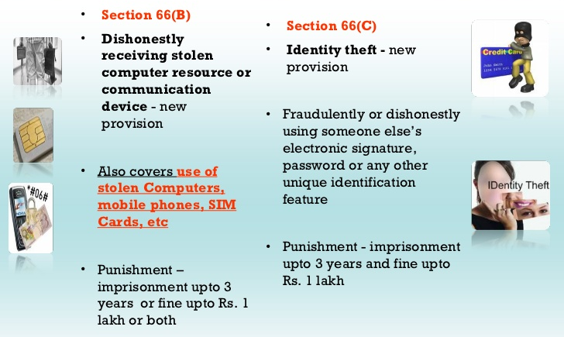

Slide 12
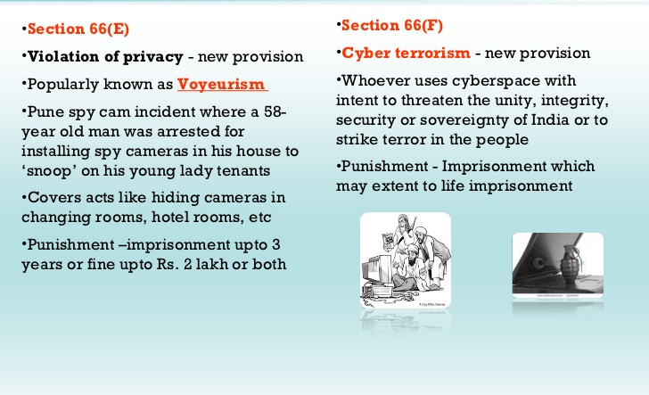

Slide 13
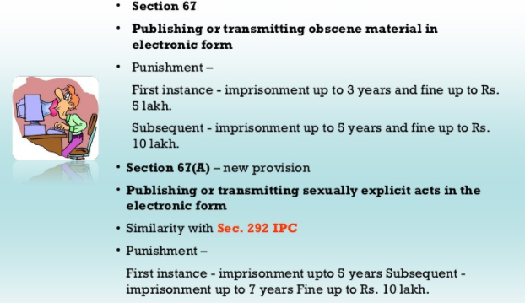

Slide 14
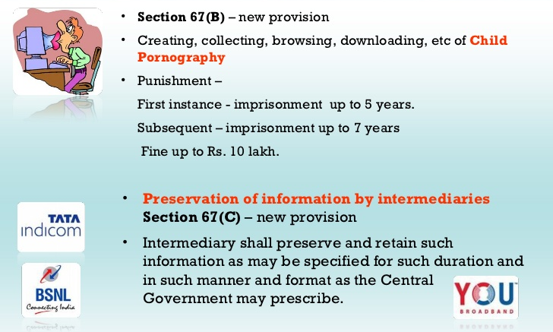

Slide 15
Section | Offence | Punishment | Bailability and Congizability
65 | Tampering with Computer Source Code | Imprisonment up to 3 years or fine up to Rs 2 lakhs | Offence is Bailable, Cognizable and triable by Court of JMFC.
66 | Computer Related Offences | Imprisonment up to 3 years or fine up to Rs 5 lakhs | Offence is Bailable, Cognizable and
66-A | Sending offensive messages through Communication service, etc... | Imprisonment up to 3 years and fine | Offence is Bailable, Cognizable and triable by Court of JMFC
66-B | Dishonestly receiving stolen computer resource or communication device | Imprisonment up to 3 years and/or fine up to Rs. 1 lakh | Offence is Bailable, Cognizable and triable by Court of JMFC
66-C | Identity Theft | Imprisonment of either description up to 3 years and/or fine up to Rs. 1 lakh | Offence is Bailable, Cognizable and triable by Court of JMFC
66-D | Cheating by Personation by using computer resource | Imprisonment of either description up to 3 years and /or fine up to Rs. 1 lakh | Offence is Bailable, Cognizable and triable by Court of JMFC
66-E | Violation of Privacy | Imprisonment up to 3 years and /or fine up to Rs. 2 lakh | Offence is Bailable, Cognizable and triable by Court of JMFC
66-F | Cyber Terrorism | Imprisonment extend to imprisonment for Life | Offence is Non-Bailable, Cognizable and triable by Court of Sessions

Slide 16
Section | Offence | Punishment | Bailability and Congizability
67 | Publishing or transmitting obscene material in electronic form | On first Conviction, imprisonment up to 3 years and/or fine up to Rs. 5 lakh On Subsequent Conviction imprisonment up to 5 years and/or fine up to Rs. 10 lakh | Offence is Bailable, Cognizable and triable by Court of JMFC
67-A | Publishing or transmitting of material containing sexually explicit act, etc... in electronic form | On first Conviction imprisonment up to 5 years and/or fine up to Rs. 10 lakh On Subsequent Conviction imprisonment up to 7 years and/or fine up to Rs. 10 lakh | Offence is Non-Bailable, Cognizable and triable by Court of JMFC
67-B | Publishing or transmitting of material depicting children in sexually explicit act etc., in electronic form | On first Conviction imprisonment of either description up to 5 years and/or fine up to Rs. 10 lakh On Subsequent Conviction imprisonment of either description up to 7 years and/or fine up to Rs. 10 lakh | Offence is Non Bailable, Cognizable and triable by Court of JMFC
67-C | Intermediary intentionally or knowingly contravening the directions about Preservation and retention of information | Imprisonment up to 3 years and fine | Offence is Bailable, Cognizable.
68 | Failure to comply with the directions given by Controller | Imprisonment up to 2 years and/or fine up to Rs. 1 lakh | Offence is Bailable, Non-Cognizable.
69 | Failure to assist the agency referred to in sub section (3) in regard interception or monitoring or decryption of any information through any computer resource | Imprisonment up to 7 years and fine | Offence is Non-Bailable, Cognizable.

Slide 17
Section | Offence | Punishment | Bailability and Congizability
69-A | Failure of the intermediary to comply with the direction issued for blocking for public access of any information through any computer resource | Imprisonment up to 7 years and fine | Offence is Non-Bailable, Cognizable.
69-B | Intermediary who intentionally or knowingly contravenes the provisions of sub-section (2) in regard monitor and collect traffic data or information through any computer resource for cybersecurity | Imprisonment up to 3 years and fine | Offence is Bailable, Cognizable.
70 | Any person who secures access or attempts to secure access to the protected system in contravention of provision of Sec. 70 | Imprisonment of either description up to 10 years and fine | Offence is Non-Bailable, Cognizable.
70-B | Indian Computer Emergency Response Team to serve as national agency for incident response. Any service provider, intermediaries, data centres, etc., who fails to prove the information called for or comply with the direction issued by the ICERT. | Imprisonment up to 1 year and/or fine up to Rs. 1 lakh | Offence is Bailable, Non-Cognizable
71 | Misrepresentation to the Controller to the Certifying Authority | Imprisonment up to 2 years and/ or fine up to Rs. 1 lakh. | Offence is Bailable, Non-Cognizable.
72 | Breach of Confidentiality and privacy | Imprisonment up to 2 years and/or fine up to Rs. 1 lakh. | Offence is Bailable, Non-Cognizable.
72-A | Disclosure of information in breach of lawful contract | Imprisonment up to 3 years and/or fine up to Rs. 5 lakh. | Offence is Cognizable, Bailable
73 | Publishing electronic Signature Certificate false in certain particulars | Imprisonment up to 2 years and/or fine up to Rs. 1 lakh | Offence is Bailable, Non-Cognizable.
74 | Publication for fraudulent purpose | Imprisonment up to 2 years and/or fine up to Rs. 1 lakh | Offence is Bailable, Non-Cognizable.

